Slide 1
Isometric

Slide 2
References
Introduction To Isometric Engines
http://www.gamedev.net/reference/articles/article744.asp
Tile/Map-Based Game Techniques: Handling Terrain Transitions
http://www.gamedev.net/reference/articles/article934.asp

Slide 3
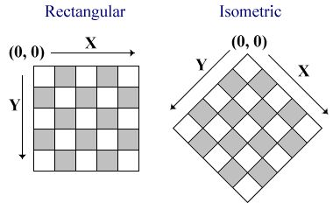
Isometric

Slide 4
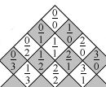
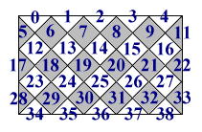
Isometric
What is the “rule” of (x,y) ?

Slide 5
Isometric
-2
-1
0
1
0
-2
-1
1
2
1
-1
2
2
-1
3
3
4
0
5
4
Left to right: x++ ; y—
Top to Bottom:
if ( row = even ) y0++ else x0++

Slide 6
Isometric
-2
-1
0
1
0
-2
-1
1
2
1
-1
2
2
-1
3
(x_{v}, y_{v)}
3
4
0
5
4
View port coordinate (x_{v}, y_{v}) to MAP coordiate (M_{x} , M_{y})
tile_width, tile_height
V_{MX} , V_{MY}

Slide 7
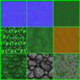
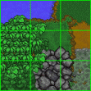
Terrain transition
HOW?
Create tile for each combination?

Slide 8


Terrain transition
Terrain Transition Template (needs only 8 bits !!!!)
Terrain precedence: jungle, forest, mountain, hill, swamp, deserts, grassland, water (open water or river)
Precalcuate transition map for each location
Draw base terrain
Draw overlay terrains in reverse order of precedence

Slide 9
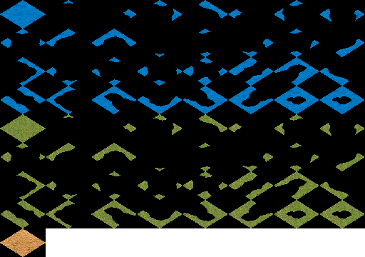
Terrain transition in isometric

